Slide 1


ANNA UNIVERSITY, CHENNAI – 600 025
R.M.K. COLLEGE OF ENGINEERING AND TECHNOLOGY DEPARTMENT OF ELECTRONICS AND COMMUNICATION ENGINEERING
B.E – PROJECT REVIEW- DATE: 26.03.2024
A Smart Integrated System For Enhanced Safety In Underground Work Environments
By
Sowmya.B - 111620106096
Sundaravalli.S - 111620106102
Yerriveera Mahitha - 111620106126
Somu Akhileswari - 111620106095
SUPERVISOR
Dr.K.Dhivya
Assistant professor, Dept of ECE

Slide 2
CONTENTS
1. INTRODUCTION
2. OBJECTIVES
3. LITERATURE REVIEW
4. IDENTIFIED GAP/PROBLEM
5. PROPOSED SYSTEM
6. RESULTS & DISCUSSION
7. CONCLUSION
8. FUTURE SCOPE
9.REFERENCES
10.PUBLICATIONS

Slide 3
INTRODUCTION
The IoT-based Underground Environment Monitoring System is an innovative safety solution for subterranean environments.
It incorporates gas, temperature, humidity, fire, vibration sensors for real-time data monitoring.
Including an LED indicator and a buzzer enhances responsiveness by providing visual and auditory alerts in critical conditions.
This solution aims to proactively address safety concerns, empowering workers and supervisors with immediate information for prompt decision-making in challenging underground workspaces.

Slide 4
OBJECTIVES
To develop an loT-based safety monitoring system for underground workers.
To monitor gas levels, temperature, humidity, fire, and vibrations in the underground environment.
Enhance worker safety by providing proactive monitoring and timely notifications in challenging underground conditions.

Slide 5
LITERATURE REVIEW
YEAR | TITLE OF THE PAPER | METHOD | RESULTS/ PARAMETERS WITH VALUES | FEATURES/ DRAWBACKS
2023 | Coal Mine Safety And Health Monitoring System | Conduct a comprehensive risk assessment to identify potential hazard in the coal mine | Real time updates Quick alert | Training needed False alarms
2022 | Coal Mine Safety Monitoring and Alerting System | This encompasses designing, testing, and deploying a WSN | Price is modest Crucial for the health and safety | Requires stable internet connection
2020 | Construction of harmful gas monitoring system | Design a comprehensive system architecture with integration of sensors | Real-time Alerts Reduced Exposure to Harmful Gases | Maintenance Requirements Privacy Concern

Slide 6
IDENTIFIED GAP/PROBLEM
In underground work environments, ensuring the safety and well-being of workers is a paramount concern due to the presence of various potential hazards such as gases, temperature fluctuations, humidity variations, fire risks, soil conditions, and structural vibrations.
The lack of real-time monitoring and timely alerts in these environments increases the risk of accidents and compromises the safety of underground workers.

Slide 7
PROPOSED SYSTEM
All the values obtained from each sensor will be changing and that sensor values is feed as input to Arduino Uno through Analog and Digital pins and here LED, buzzer, LCD I2C is also connected to Arduino Uno to digital pins. The values obtained from the sensor will be analysed and the data will be sent to ESP8266 Node MCU through Transmitter and Receiver pin, as Arduino is connected to the Receiver of ESP8266 and viceversa. So this pins are used for Transmitting and Receiving the data information.Now the data will be received from Arduino.
The ESP8266 Node MCU will analyse the data for each sensor and it also checks for the threshold value of each sensor.The logic given in this circuit is it will check for the threshold value of each sensor and even if anyone of sensor exceeds the threshold value then it must automatically alert and immediately sent to the communication device.
For eg if the Carbon monoxide value alone exceeds the threshold then immediately sent to communication device like LED and Buzzer.After alerting through communication device it is sent for Data Visualization through Matlab and Machine learning.
Suppose if the sensor value doesnot exceed with the threshold value then it is sent directly for Data Visualization. LCD will also be connected to this device to display the real time data of each sensor. Therefore, the outputs are obtained through graph with respect to time in sec in Matlab and as the actual values are given predicted values are obtained with respect to in Machine Learning.

Slide 8
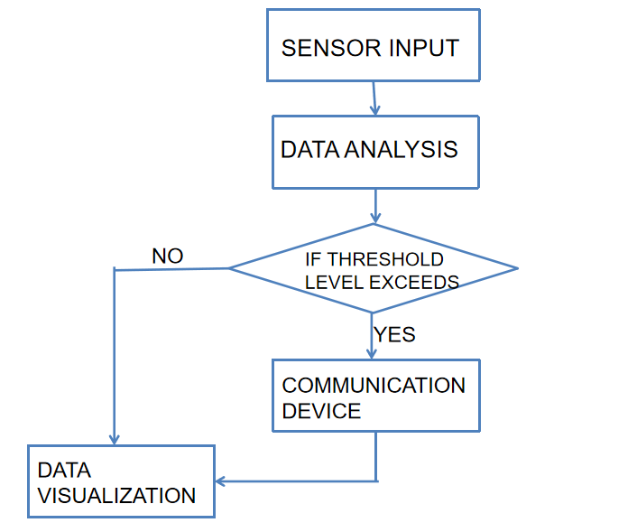
PRPOSED SYSTEM - BLOCK DIAGRAM

Slide 9
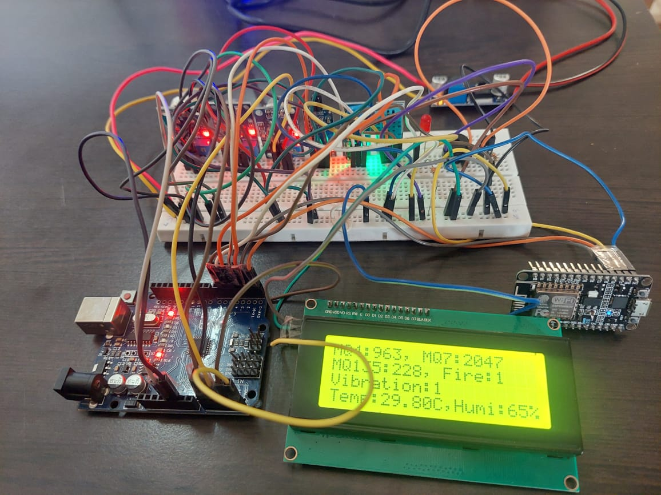
IMPLEMENTATION & TESTING

Slide 10
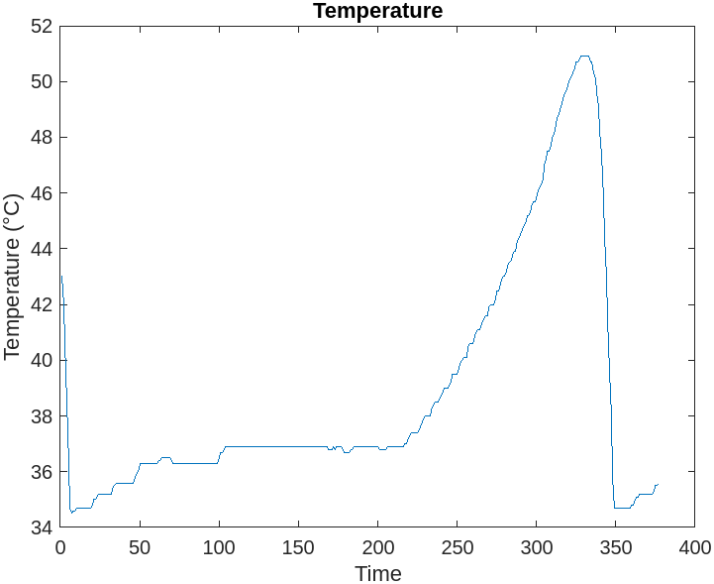
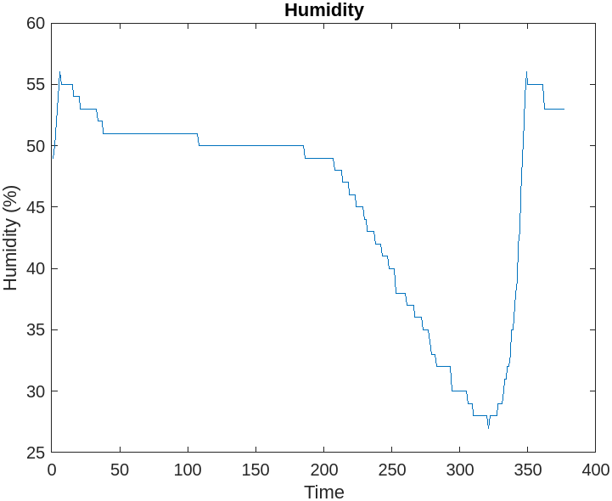
RESULTS
Obtained from MATLAB

Slide 11
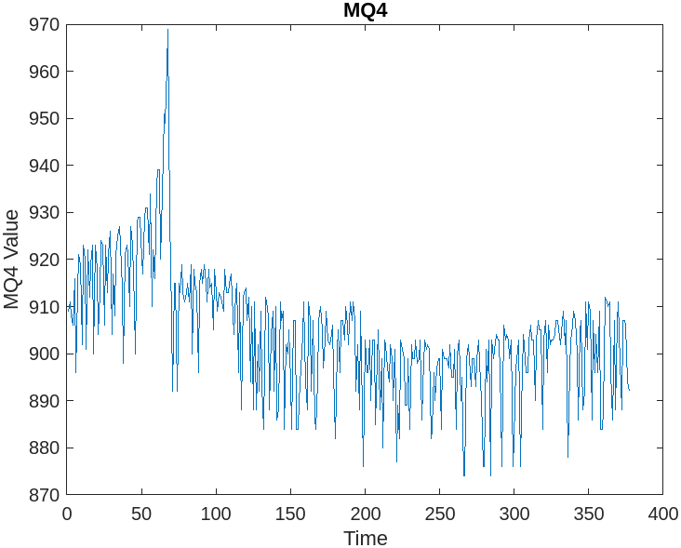
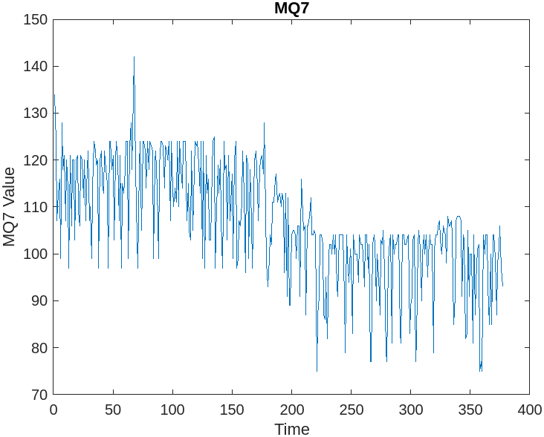

Slide 12
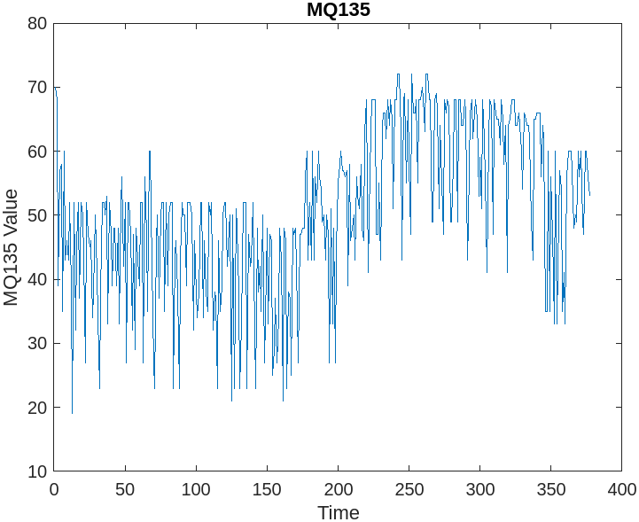
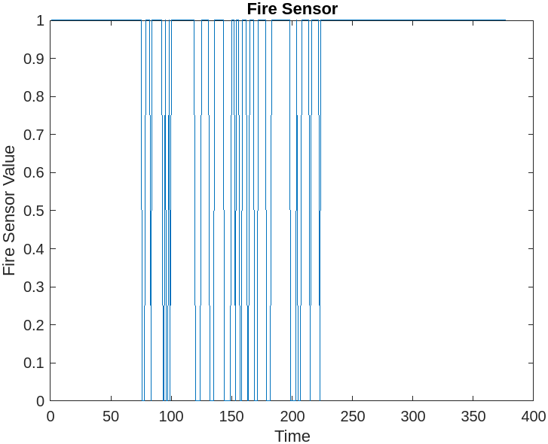
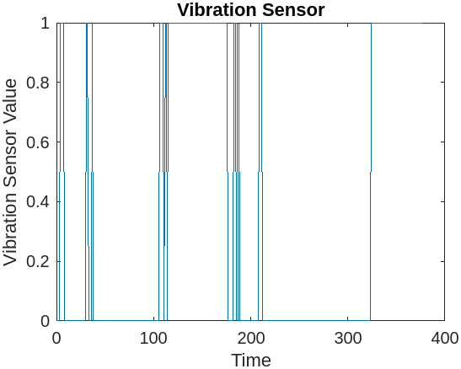

Slide 13
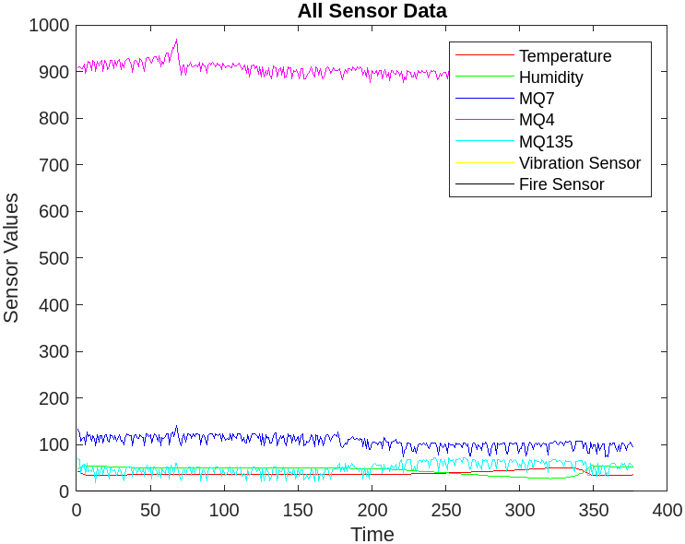

Slide 14
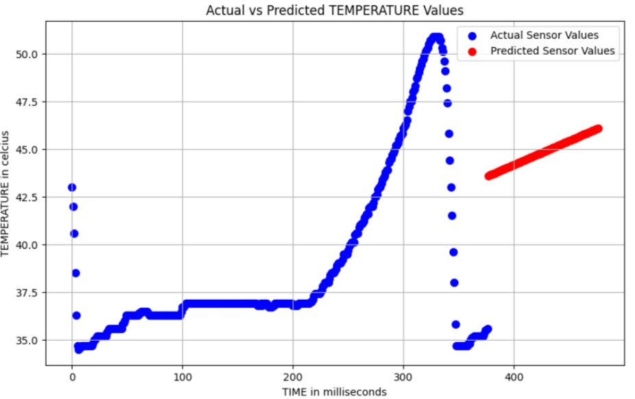
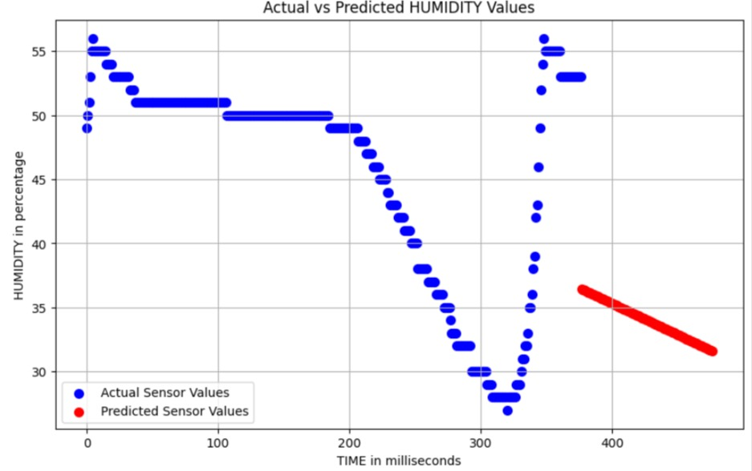
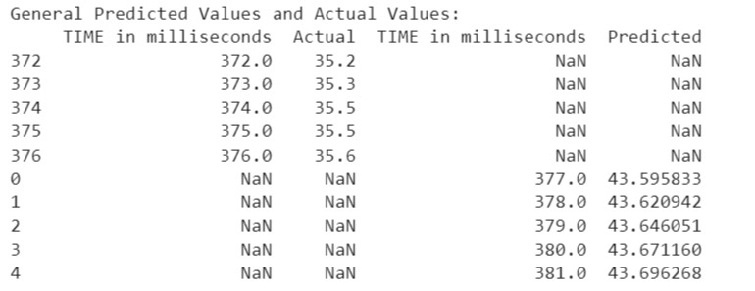
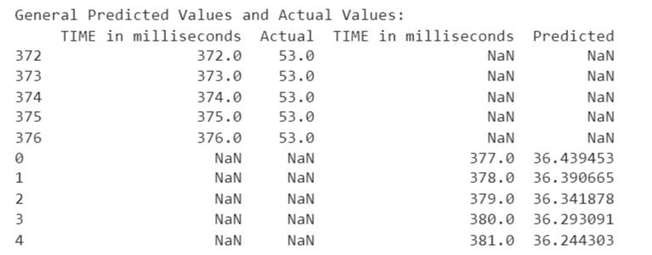
Results obtained by using Machine Learning

Slide 15
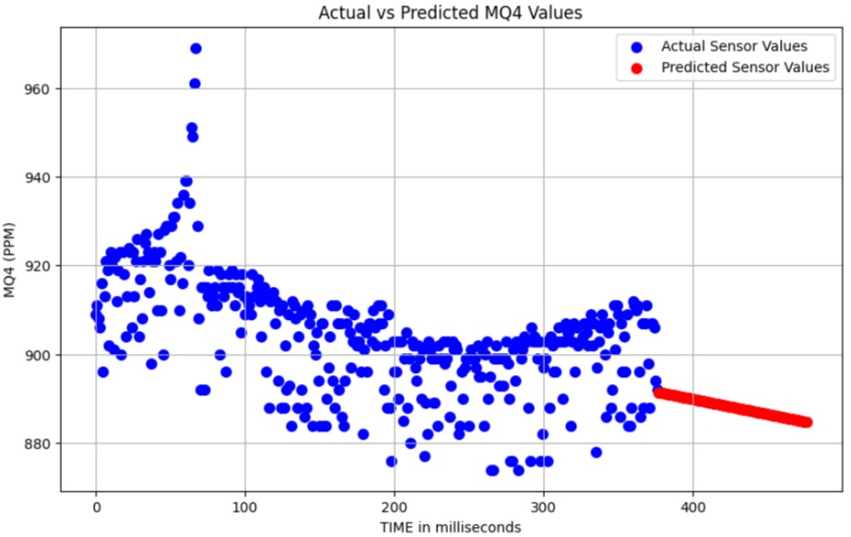
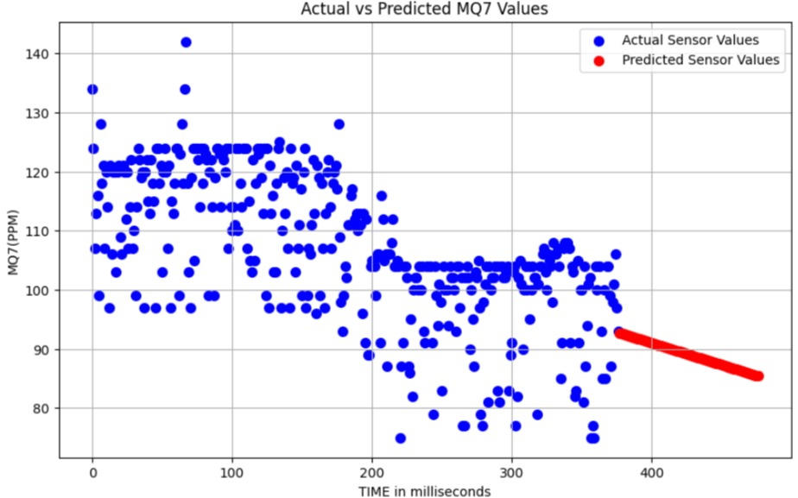
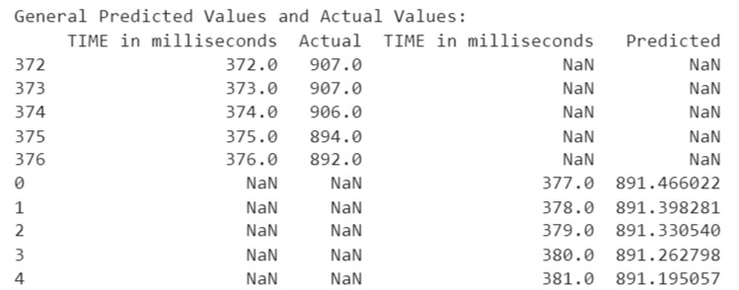
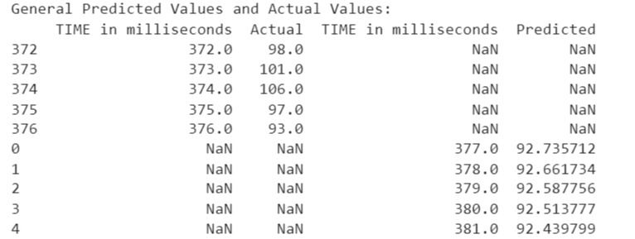

Slide 16
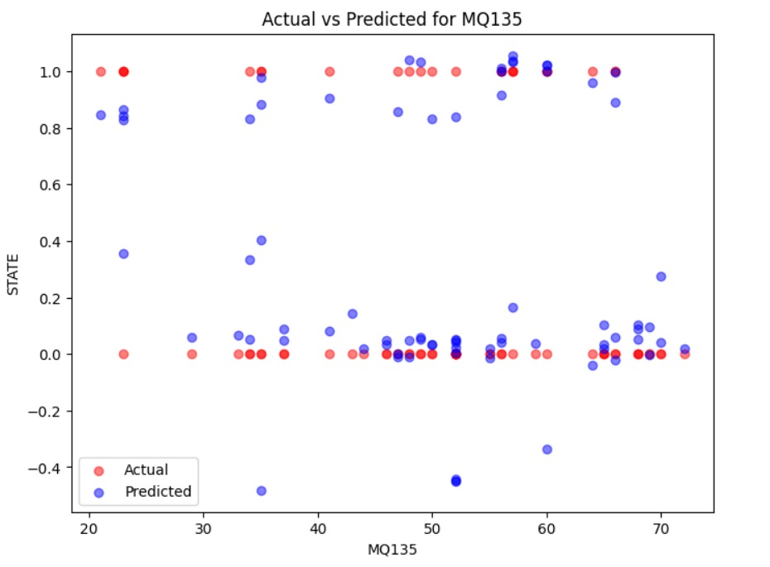
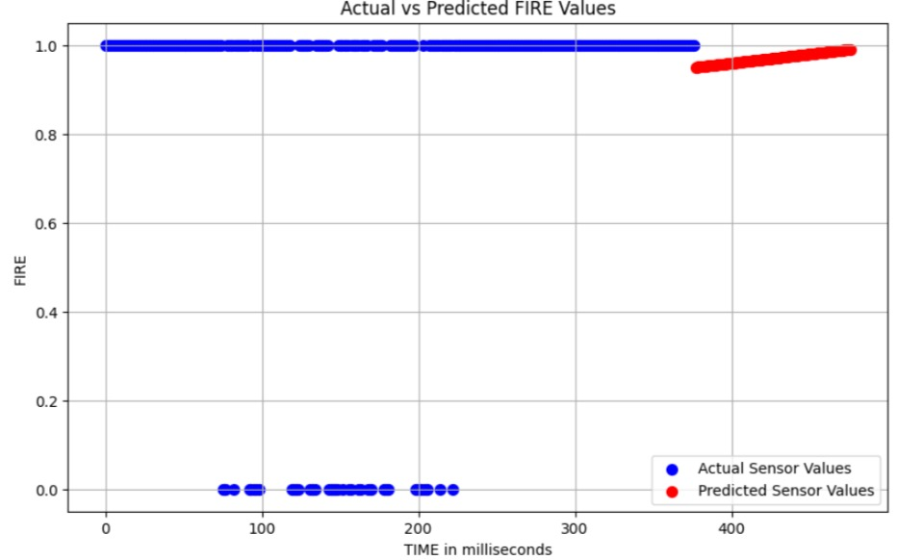
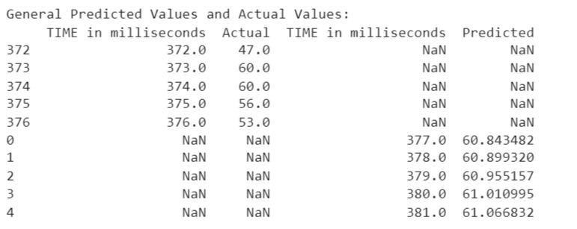
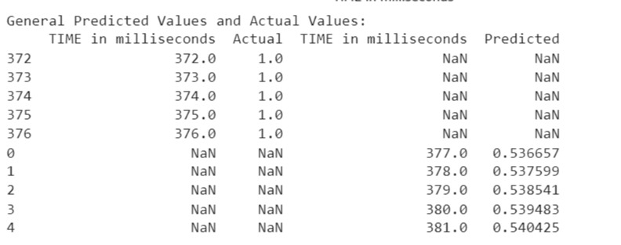

Slide 17
CONCLUSION
The developed loT-based underground workers monitoring system effectively integrates multiple sensors for real-time tracking of environmental parameters.
Due to leakage of carbon monoxide around 31 people died in China. Due to Mine Explosion around 40 people have died in Bartin.
So to overcome these accidents we are implementing this project by using various sensors.

Slide 18
FUTURE SCOPE
The future scope for a smart integrated system aimed at enhancing safety in underground work environments is vast and promising. By leveraging advanced sensing technologies, machine learning algorithms, and autonomous systems, the project can evolve to predict and prevent safety hazards in real-time. Integrating communication systems, virtual reality training, and wearable technology can further empower workers with essential tools and knowledge to navigate underground environments safely. Additionally, exploring robotics for hazardous tasks, data analytics for safety insights, and augmented reality for navigation can significantly improve overall safety standards. Continuous innovation in these areas promises not only to mitigate risks but also to revolutionize how underground work environments are managed, ensuring the well-being of workers and optimizing operational efficiency.

Slide 19
REFERENCES
Li Z D , Feng G H , Feng X. Design of Gas Density Monitor System based on Wireless Sensor Network[J].Applied Mechanics & Materials, vol.716,no.717,pp.888-891, May 2015.
Muduli L , Mislira D P , Jana P K . Application of wireless sensor network for environmental monitoring in underground coal mines: A systematic review[J]. Journal of Network and Computer Applications, vol.106,pp.48-67, Mar 2017.
Singh, A., Singh, U. K., & Kumar, D. (2018,March). IoT in mining for sensing, monitoring and prediction of underground mines roof support.4th International Conference on Recent Advances in Information Technology (RAIT).
Gautam Gowri shankar anand Charles He ,“Productivity ,safety and regulation in underground coalmining :Evidence from disasters and fatalities,”Arizoneducation,March2017

Slide 20
Thank you

